Slide 1
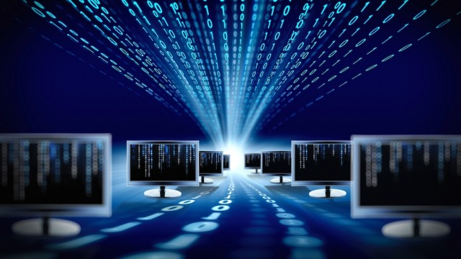
MODULE I: INTRODUCTION

Slide 2
Lesson 1: Data Vs. Information

Slide 3
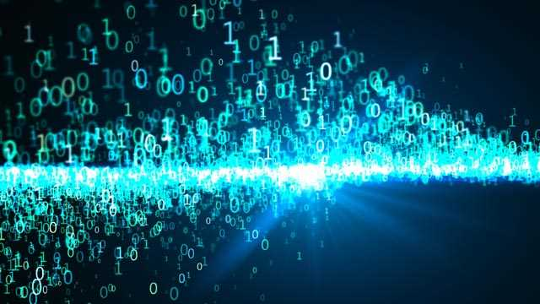
DATA
Data is raw, unorganized facts that need to be processed. Data can be simple and seemingly random and useless until it is organized

Slide 4
DATA
Example : each student test score is one piece of data.
Etymology: its date early 1600s, it comes from Latin names which originally means “Something given”

Slide 5
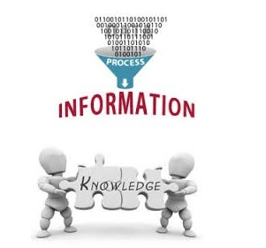
INFORMATION
Meaning: When data is processed, organized, structured or presented in a given context so as to make it useful, it is called information

Slide 6
INFORMATION
Example: The average score of a class or of the entire school is information that can be derived from the given data.
Etymology : it dates early 1300s, it has old and middle English origins. It has always referred to “the act of informing ” usually in regard to Education, instruction, or other knowledge communication

Slide 7

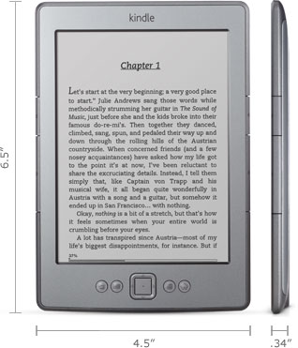
FORMAT OF INFORMATION
Information is available and accessible in two main formats namely, print and non-print, these include published and unpublished sources.
Print materials : All printed books, periodicals, maps …
Non-printed materials: Audio, audiovisual, multimedia, electronic books….

Slide 8
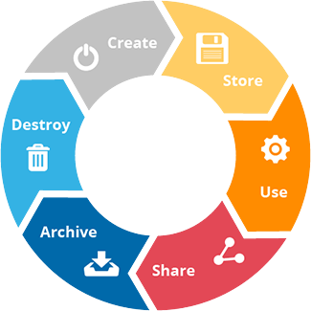
INFORMATION LIFE CYCLE

Slide 9

INFORMATION SYSTEMS
These are interrelated components working together to collect, process, store, and disseminate information to support decision making, coordination, control, analysis and visualization in an organization.

Slide 10
INFORMATION SYSTEMS COMPONENTS
Hardware
Software
DBMS
Network
People
Process

Slide 11
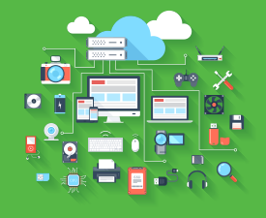
INFORMATION TECHNOLOGY
IT is the subset of information systems, it used the Hardware, software, DBMS and Network to create, Store, process, secure and exchange all forms of electronic data

